Slide 1
Together towards a zero-carbon emissions, circular world
October 2023

Slide 2
Contents
The Journey: Introducing Zeremis
  Our track record
  Our ambition
Driving transformation
Accelerating change
  Zeremis Carbon Lite
  Reinvesting in the future

Slide 3
The journey

Slide 4
®
        Zeremis – short for zero emissions –
        is our promise to the planet to become carbon neutral by 2045. The Zeremis brand
        represents the journey Tata Steel Nederland is
        taking with our customers, together towards a
        zero-carbon emissions, circular world.
Notes:
Zeremis – short for zero emissions – is our promise to the planet to become carbon neutral by 2045. The Zeremis brand represents the journey Tata Steel Nederland is taking with our customers, together towards a zero carbon emissions, circular world.

Slide 5


        We will be introducing a range of new
        solutions under the Zeremis brand covering the full supply chain
®
Low carbon emission steel
Carbon Lite
Recycled
content
Zero-carbon logistics
Zeremis Delivered.
Carbon neutral downstream operations
Partner Solutions

Slide 6
Our track record
  Today, Tata Steel Nederland is one of the most carbon efficient primary strip steel makers in the world (we consistently rank in the top 5%) and is on a journey to become carbon neutral.

Slide 7
Our ambition

Slide 8
        Tata Steel Nederland has the ambition to become CO₂e neutral by 2045 and reduce
        its CO₂e emissions by 35% to 40% by 2030

Slide 9
Driving transformation

Slide 10
        By introducing Direct Reduced Iron (DRI) technology, processed with green hydrogen, we will make a giant leap towards CO₂e neutral steelmaking in
        a clean environment at IJmuiden.
        This introduction will happen before 2030, resulting in one of the largest CO₂e reductions in steel making in Europe in a decade.

Slide 11
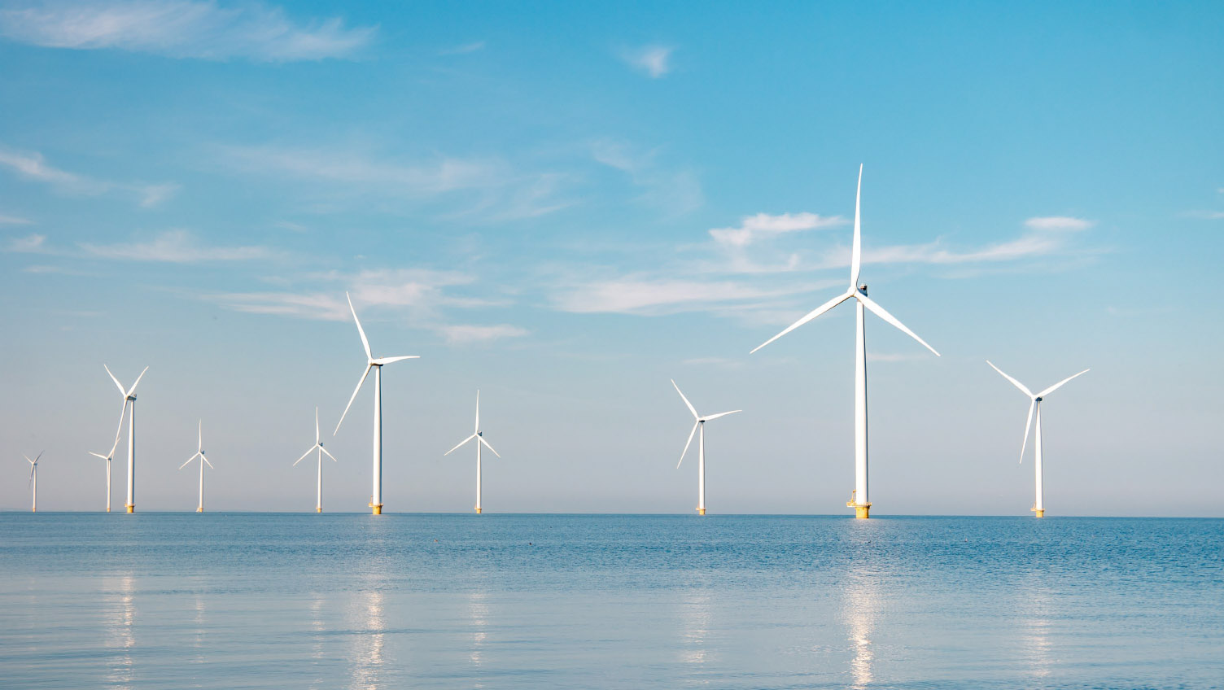
        We are already laying out the infrastructure for a
        direct connection to the TenneT offshore wind farm,
        which will enable direct access to green energy
        required to produce hydrogen on site

Slide 12
Accelerating change

Slide 13
        Whilst we undergo our transformation to a sustainable steel production process, we recognise that taking action
        on climate change can’t wait
        We must act today

Slide 14

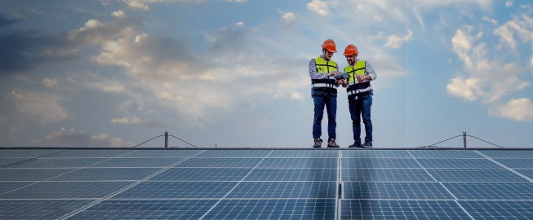
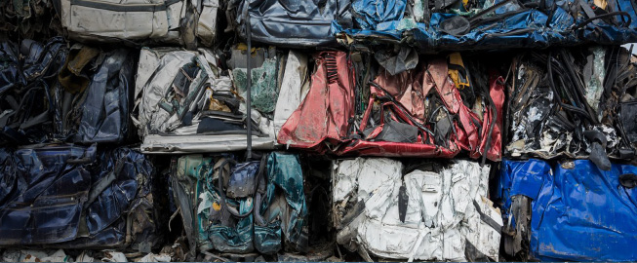

We are introducing carbon reduction and innovative circular solutions for the coming years covering our full supply chain
Certified
CO₂e savings
Carbon neutral downstream operations
Recycled content
Zero-carbon logistics

Slide 15
®
To support our joint short-term ambitions

Slide 16

®
  Enables you to reduce your carbon footprint now
  A flexible solution that lets you choose the CO₂e intensity reduction that you need
  Independently assured by DNV
  CO₂e savings can be reported as a reduction in scope 3 emissions

Slide 17








Recent carbon savings realised by Tata Steel Nederland are independently assured by DNV and compiled in our central carbon bank
Our Carbon Lite solution draws on
credits from this bank in the form
of declarations, meaning you can meet your specific carbon reduction targets.
TSN | TSN Carbon bank | Steel coils sold
Projects to reduce CO₂e
CO₂e savings
CO₂e savings
Electrification
Carbon bank
Xt CO₂
External Verification
Green
sales
Solar energy >
Renewable energy
Commit to reinvest the
sales to accelerate
Declaration
Process changes
and innovation

Slide 18
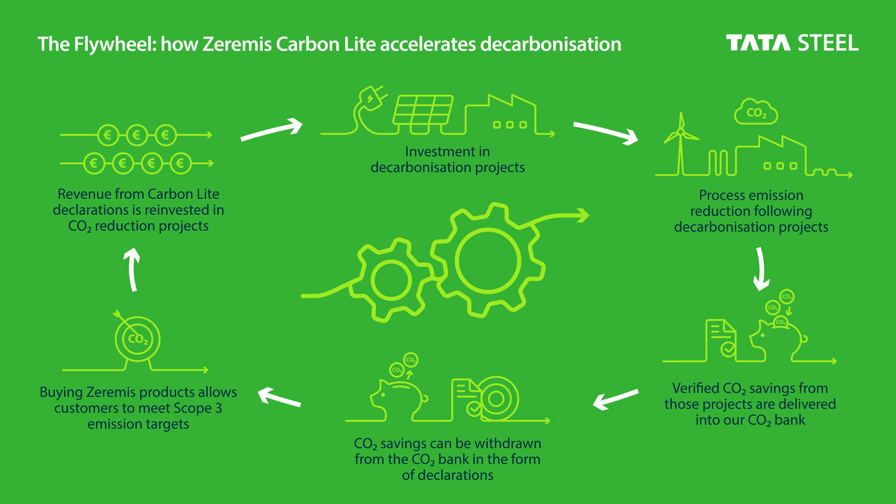

Slide 19


Slide 20
Why buy Zeremis Carbon Lite
  Carbon Lite is an insetting scheme delivering decarbonisation of your supply chain
  The CO₂ savings are real and have been made and verified by DNV
  Revenues from the sale of declarations are used to fund our Zeremis journey, so we can move faster together towards our goal
  The CO₂ savings can help you achieve your CO₂ targets and flow down supply chains
  By buying Carbon Lite from Tata Steel Nederland you are contributing to a reduction in atmospheric CO₂

Slide 21
Reinvesting in the future

Slide 22
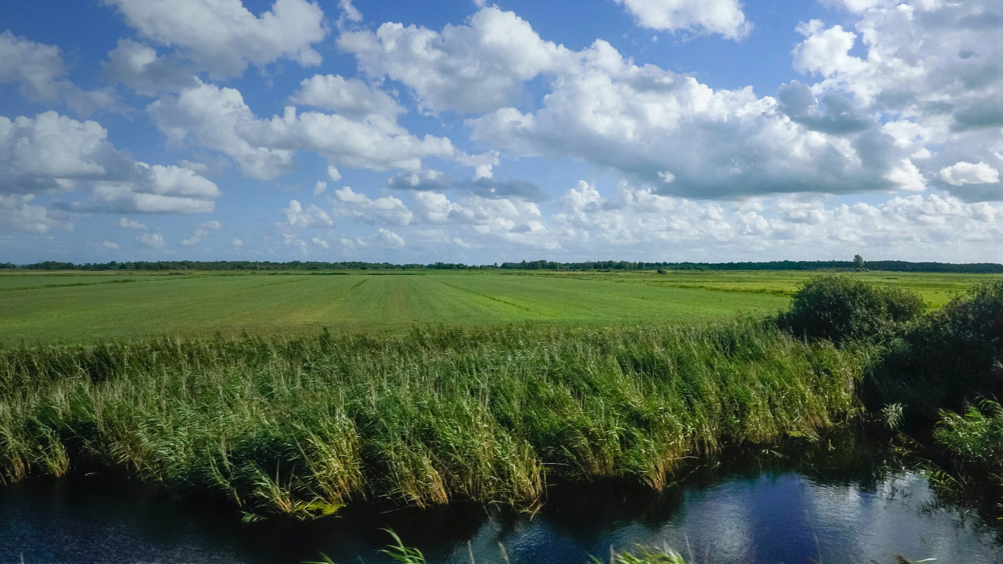
        In the true spirit of partnership, it’s our commitment that the value created with our Zeremis® Carbon Lite sales will be used to fund our Zeremis journey, so we can move faster together towards our goal

Slide 23
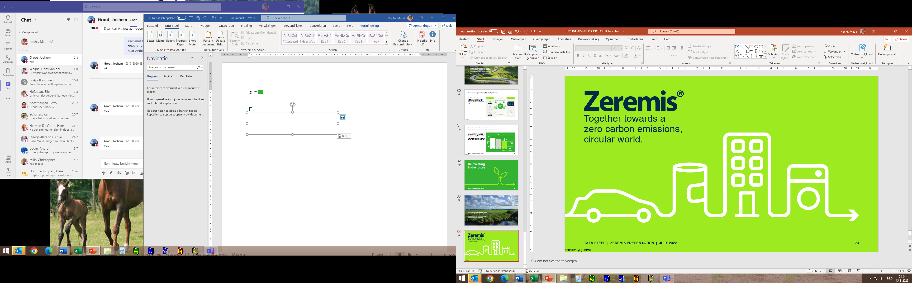
Together towards a zero-carbon emissions, circular world.
®

